Slide 1
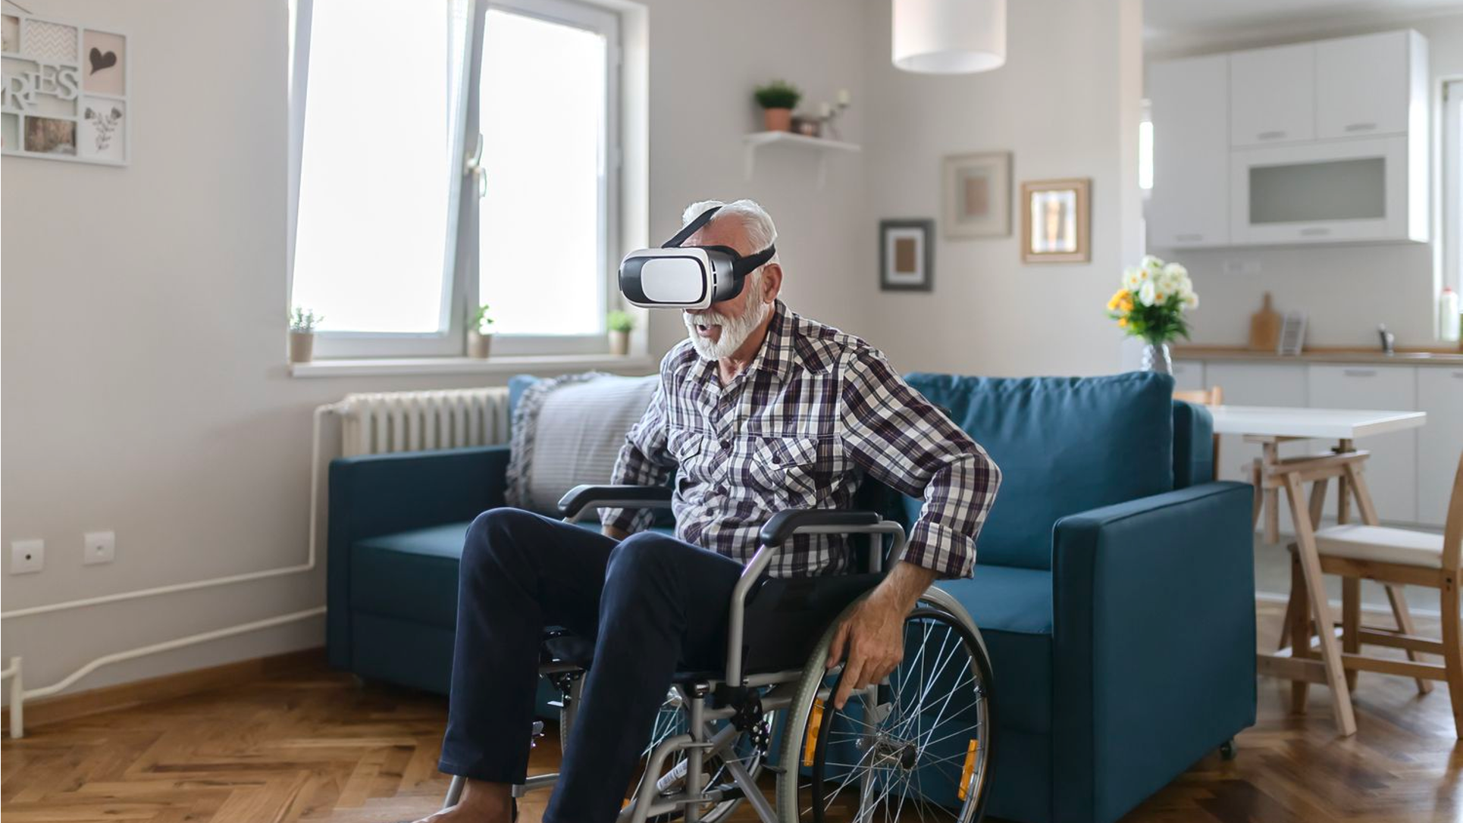
Omnidirectional Wheelchair & Learning Simulator (OWLS)
(EE) Garrett Bradshaw, (EE) Slade Hicks, (EE) Brandon Waldrup, and (CPE) Kyler Smith
[1]

Slide 2

Problem
1 in 10 people world-wide are significantly disabled [2]
1 in 10 PWD's use wheelchairs [2]
Wheelchairs don't provide the same benefit to people with mental disability

Slide 3
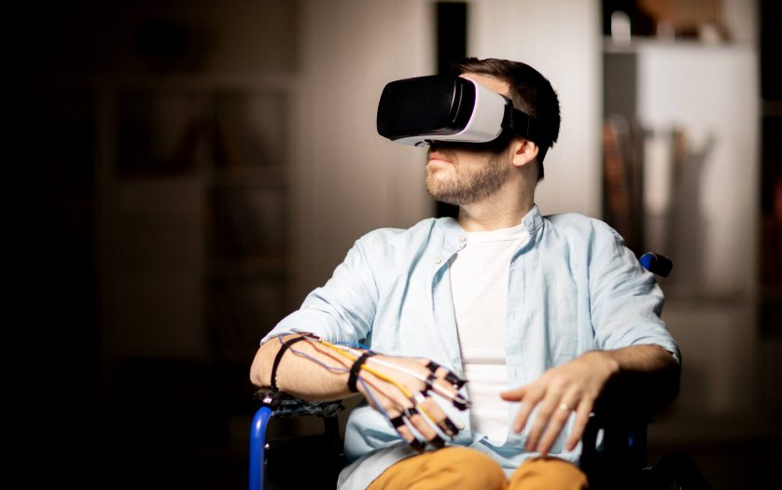
Solution
Safe environment through VR
Training on wheelchair operation and situational awareness
Omnidirectional wheels

Slide 4
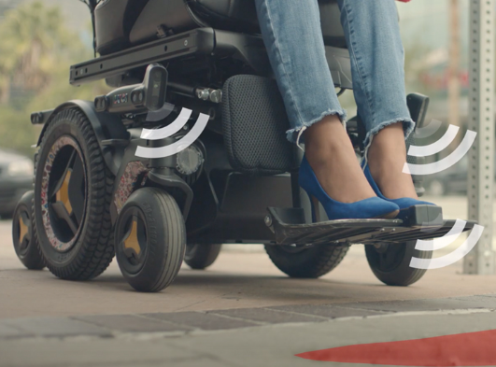
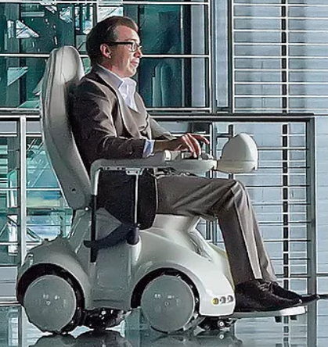
Our Competition
Luci
JCI Medical Solutions
[5]​
[6]​

Slide 5

Audience
Healthcare Facilities
Caretakers of people with Disabilities
Insurance companies
[7]

Slide 6

Marketing
Social Media
Healthcare Conventions
Targeted Web Ads
[8]

Slide 7
Sources
[1] E. Mason, "Virtual Reality Therapy May Help Improve Your Own Self Image." Verywellhealth.com. https://www.verywellhealth.com/virtual-reality-body-dysmorphia-treatment-5096868
[2] World Health Organization, "Fact sheet on wheelchairs," apps.who.int. https://apps.who.int/iris/handle/10665/205041
[3] United Spinal Association, "NYC Sidewalks Finally Complying With ADA," unitedspinal.org. https://unitedspinal.org/nyc-sidewalks-finally-complying-with-ada/
[4] S. Fisher, "How can Virtual Reality technology help persons with disabilities?." Disabilityinsider.com. https://disabilityinsider.com/story/how-can-virtual-reality-technology-help-persons-with-disabilities/
[5] Luci, "Wheelchair smarter," luci.com. https://luci.com/
[6] JCI Medical Solutions, "Omnichair," omnia-health.com. https://www.omnia-health.com/product/omnichair/
[7] L. Anderson, "A Mobility Aid May Be the Ticket to RA Freedom." Healthcentral.com. https://www.healthcentral.com/article/mobility-aid-your-next-step-to-freedom-with-rheumatoid-arthritis
[8] Physicians Committee for Responsible Medicine, “PRIM&R22.” pcrm.org. https://www.pcrm.org/sites/default/files/ICNM2018.jpg

